Slide 1

Back End Engineering
Eco-Conscious
Submitted by: Jashanjit Kaur (2210990440)
Jasjeet Kaur (2210990442)
Kamaljeet Kaur (2210990470)
Kanchan Yadav (2210990471)
Kashika (2210990493)
Submitted to:
Mr. Shiv Mohan
Chitkara University Institute of Engineering and Technology,
Chitkara University, Punjab

Slide 2
Table of Contents
Introduction
Technical Details
Database Design
Key Features
Project Highlights
Conclusion
References/Links used
Q&A

Slide 3



Introduction
Our project idea is to create an eco-friendly e-commerce platform that promotes sustainable products.
The platform not only allows users to shop for eco-friendly items but also suggests alternative products based on specific environmental criteria, helping consumers make more informed, sustainable choices.

Slide 4
Technical Details
1. MongoDB: NoSQL database used to store product data, user information.
2. Express.js: Backend web application framework that handles routing, middleware, and CRUD operations.
3. React.js: Frontend library for building the user interface.
4. Node.js: JavaScript runtime used on the server to execute backend logic and interact with the database.

Slide 5
Key Features
Sign Up & Login: Allowing new users to register and existing users to log in.
Product Categories: Organized display of products into various categories for easy navigation.
Product Profile: Detailed information page for each product.

Slide 6
Key Features
User Profile: Personalized user profiles where users can view and manage their account details.
Edit Profile: Option for users to update their personal information and preferences.
Delete Profile: Functionality for users to permanently delete their accounts if they choose.

Slide 7
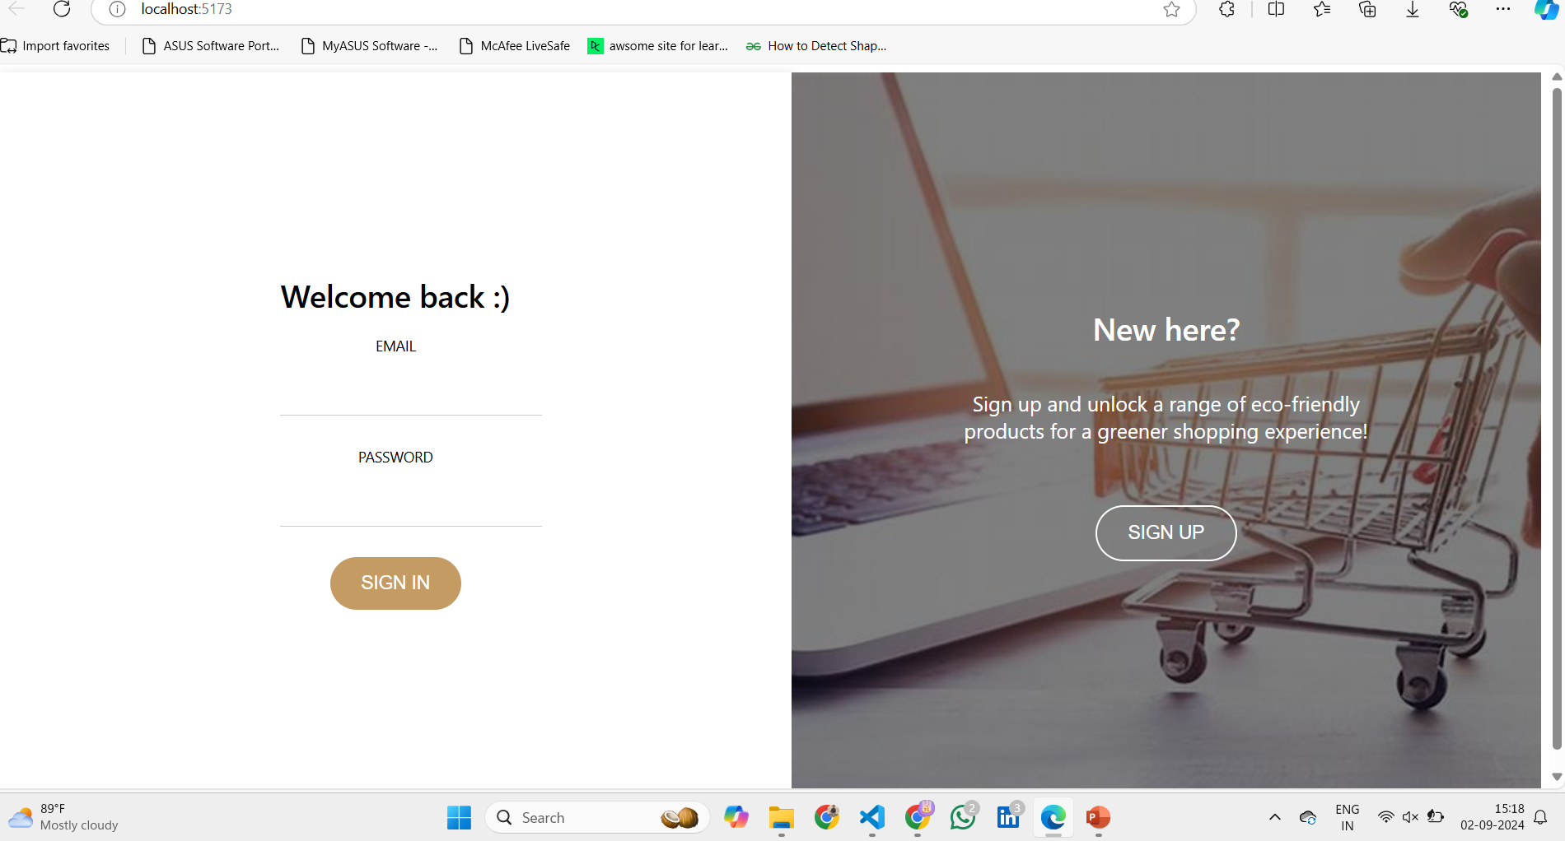
Project Highlights
Signup or Login Page:

Slide 8
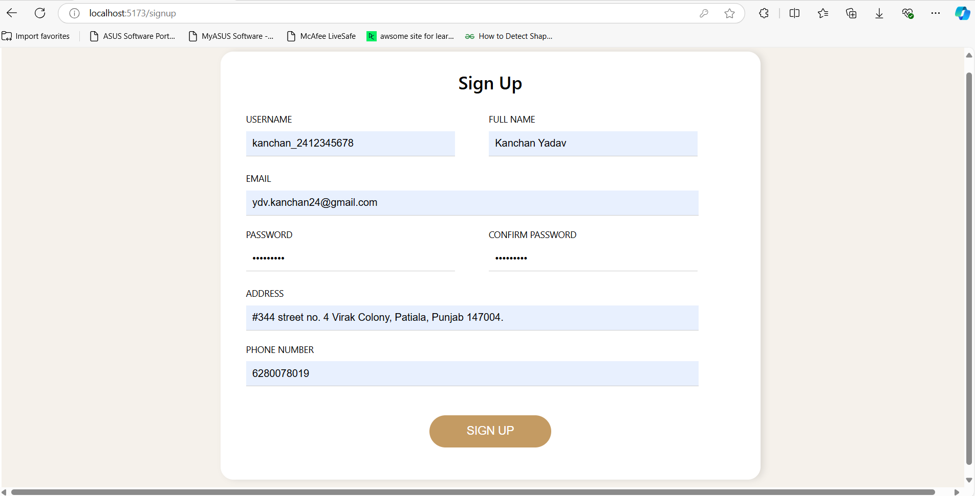
Project Highlights
Signup Page:

Slide 9
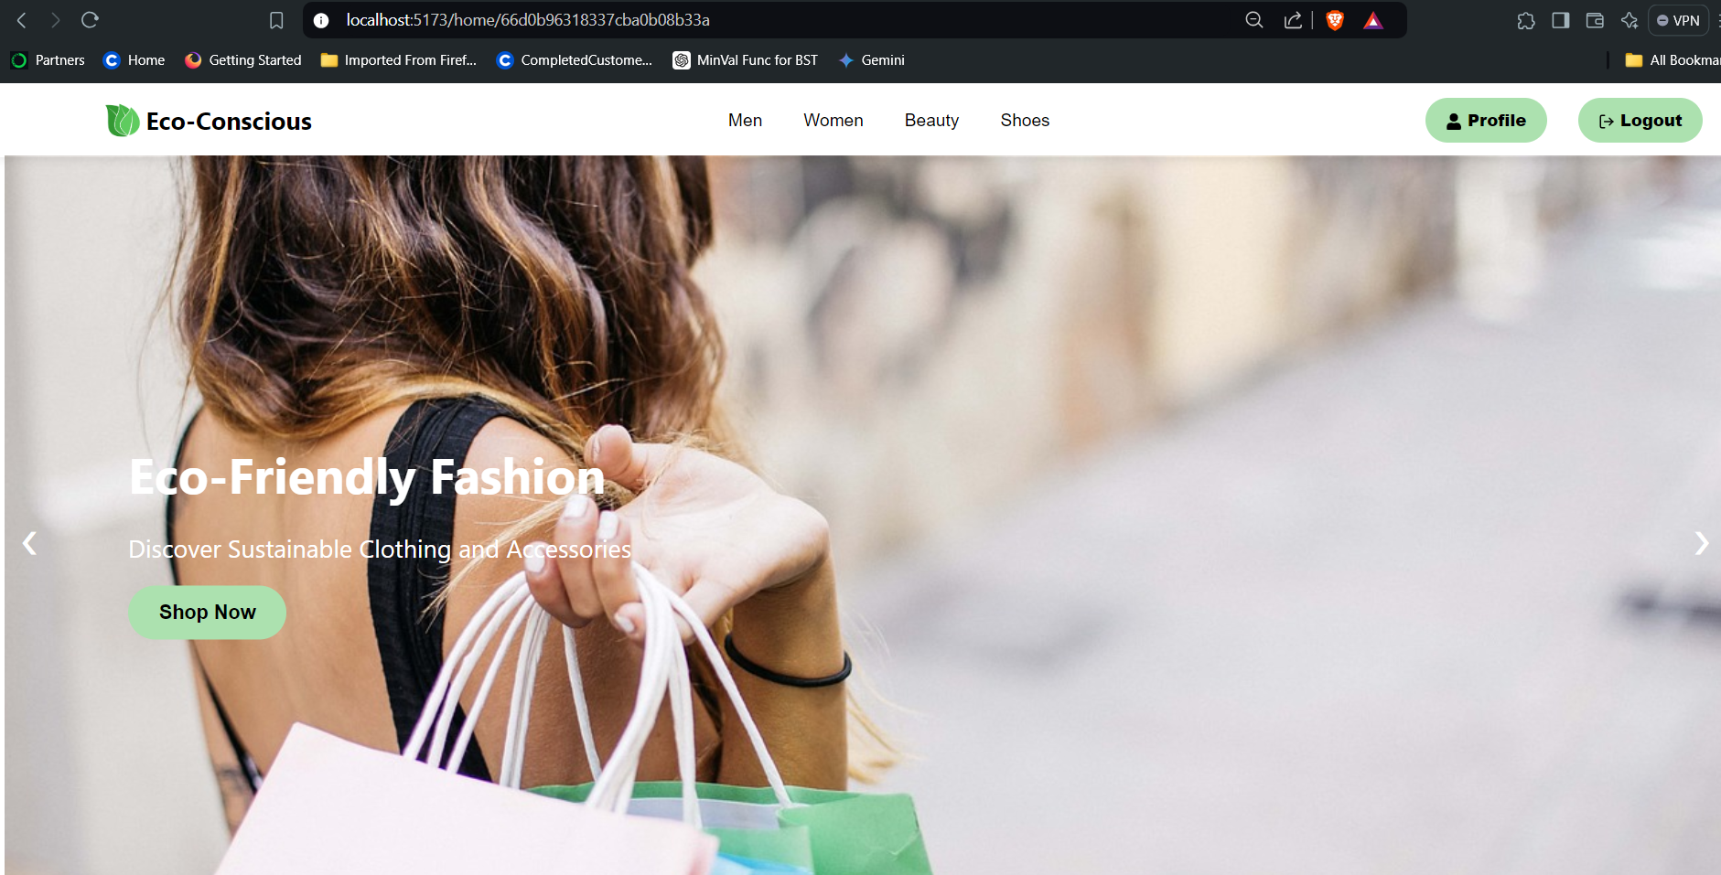
Project Highlights
Main Page:

Slide 10
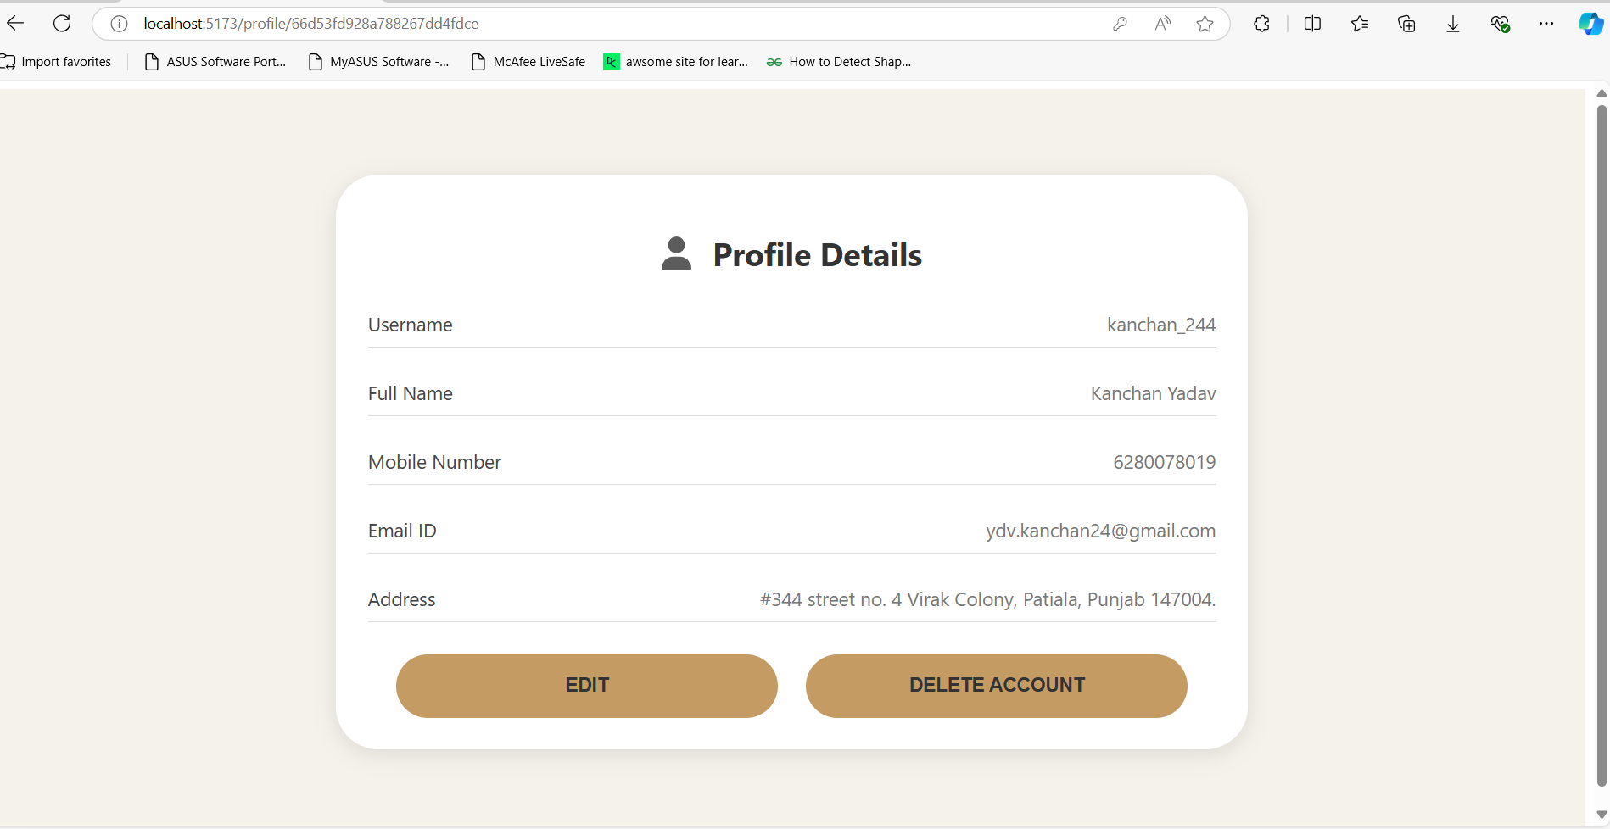
Project Highlights
User Profile Page:

Slide 11
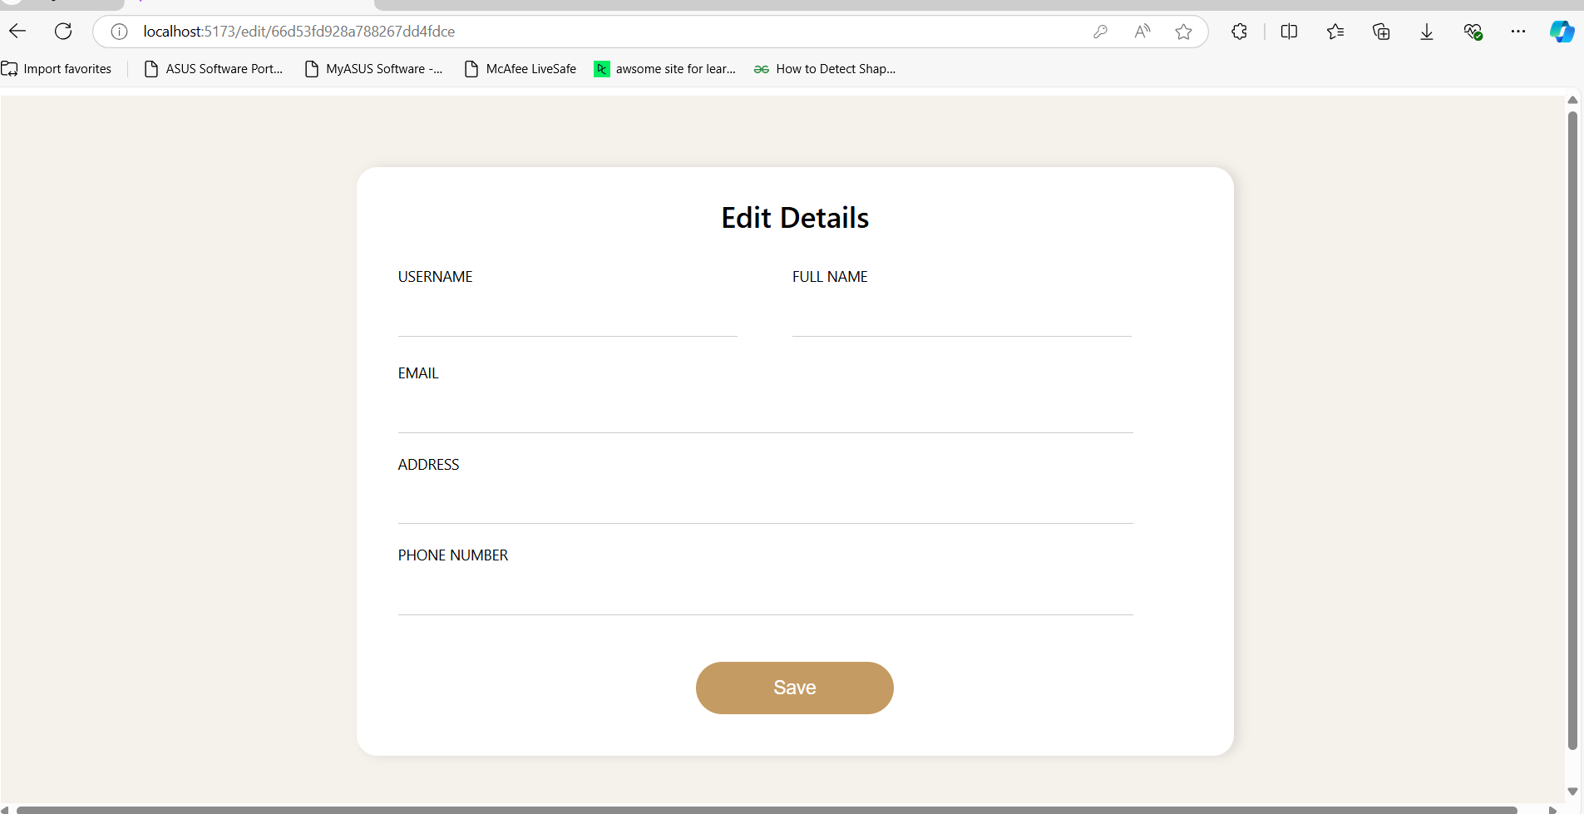
Project Highlights
Edit Details Page:

Slide 12
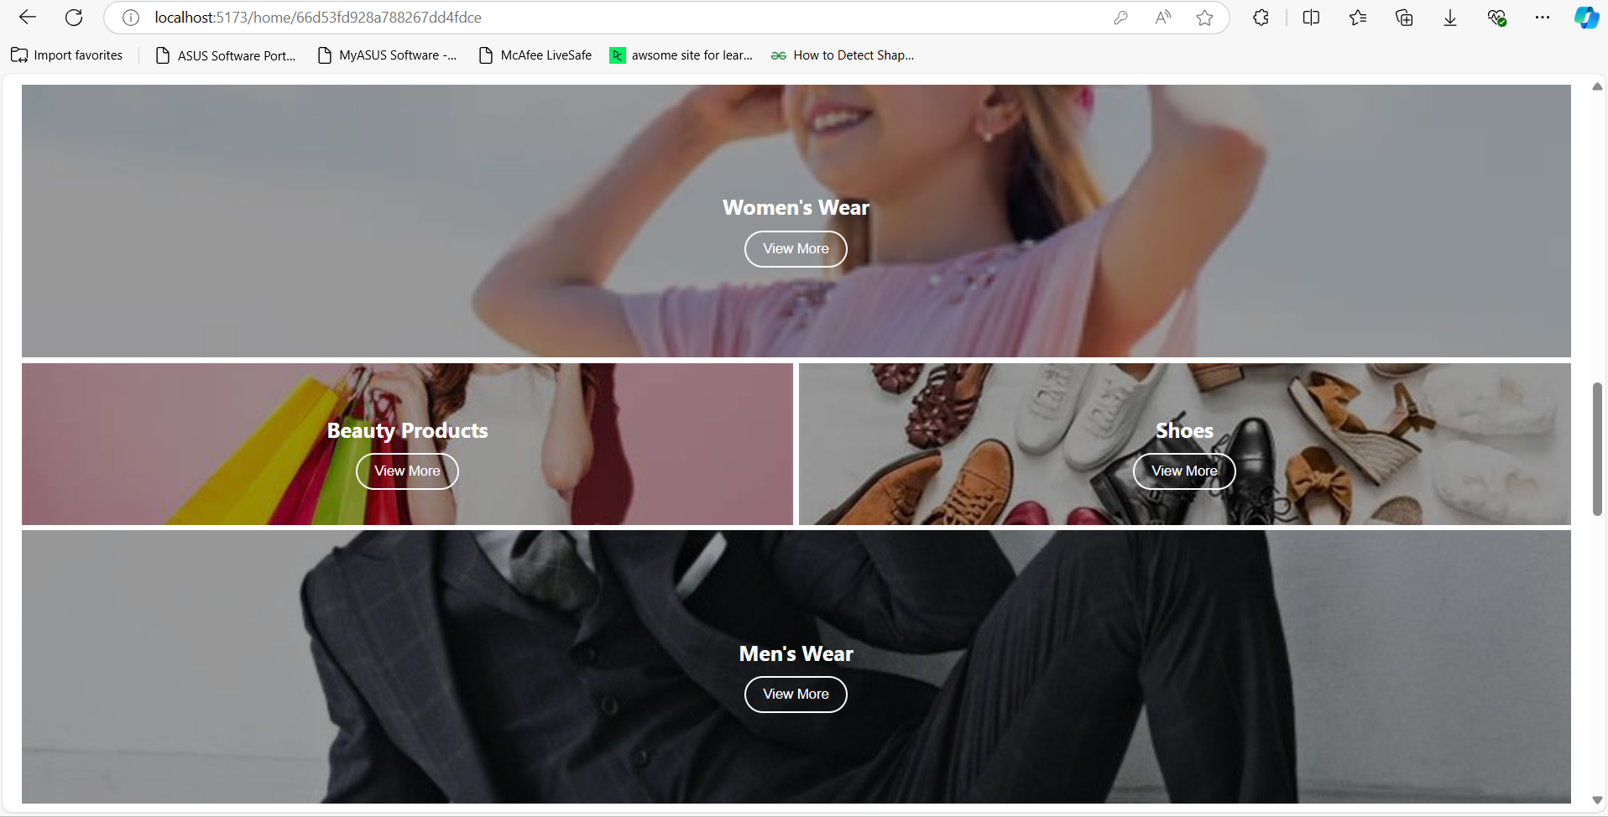
Project Highlights
Categories Page:

Slide 13
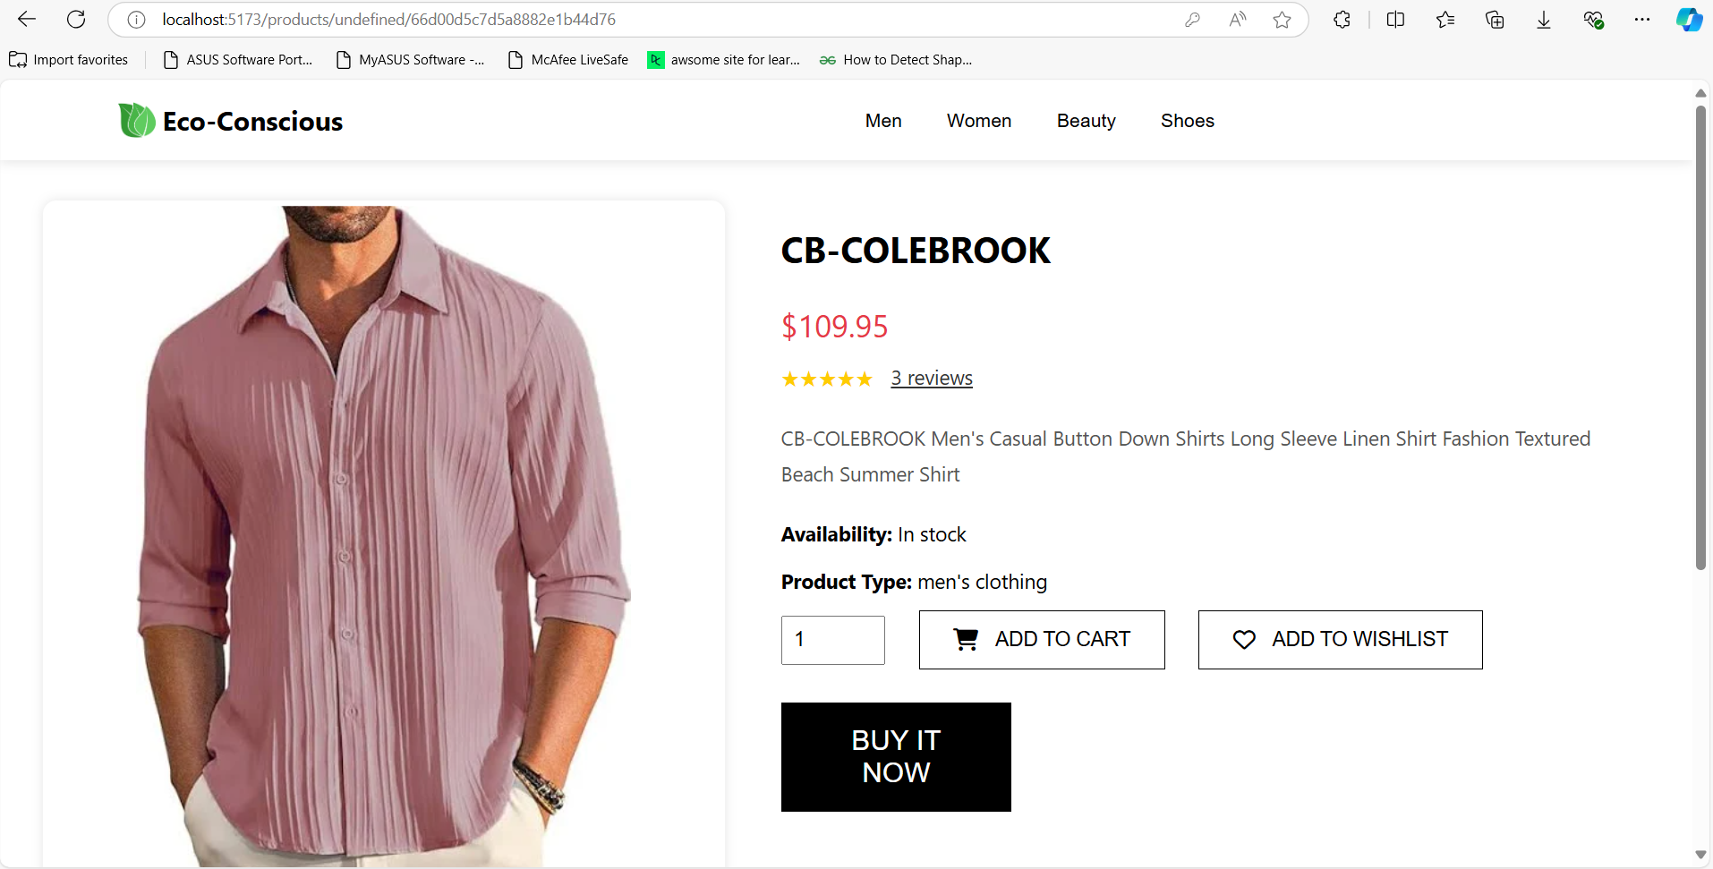
Project Highlights
Product Profile Page:

Slide 14
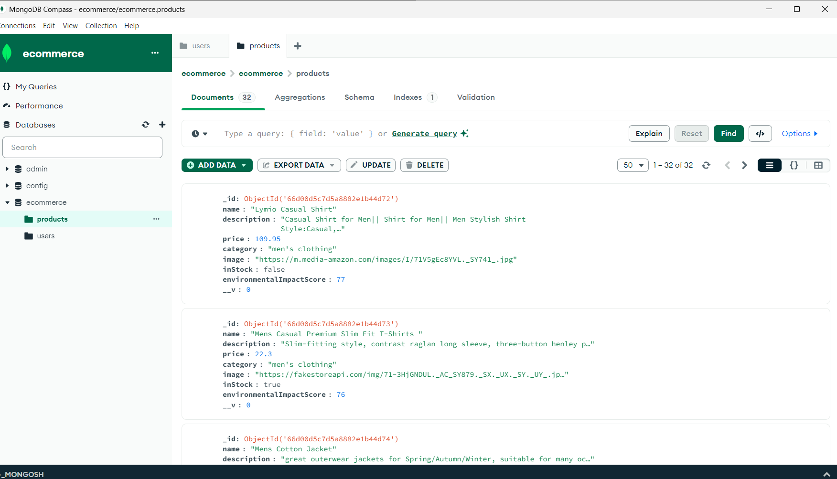
Project Highlights
Database:

Slide 15
Conclusion
We've built the core backend of our eco-friendly
e-commerce platform, successfully implementing CRUD operations and key features, we have planned to refine and expand the system in the next phase.

Slide 16
Git Repo & Deploy Site
GitHub Repository:
https://github.com/ydv-kanchan/Eco-Conscious

Slide 17
References/Links used
https://expressjs.com/
https://nodejs.org/en
https://www.mongodb.com/
https://react.dev/

Slide 18


Slide 19


